Slide 1
In India, Several Quality Awards
Name: Asees Sahni
Course: BBA(Data Analysis and Visualization)
KID: K21600
Submitted To: Dr Sandeep Kumar

Slide 2
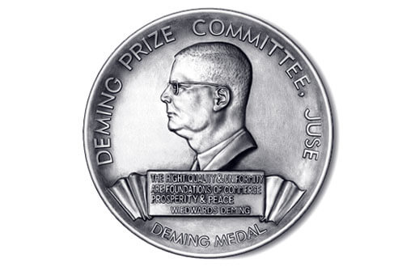
The Deming Prize
Rane Group chairman L. Ganesh, was awarded with The Deming Award for the year 2022.
He was conferred with the prestigious Deming award for outstanding contribution in dissemination and promotion (overseas) of total quality management (TQM).

Slide 3

Rajiv Gandhi National Quality Award
Dr. Ahmed Haque, was felicitated with the renowned Rajiv Gandhi Award for the year 2022.
He has concentrated on using non-formal education and Human Rights Education to combat and prevent hate speech, radicalization, and violent extremism. Advocacy for main culturalization and racism, as well as promoting democracy, human rights promotion, and good governance, is one of his key areas of endeavor.

Slide 4

Golden Peacock Award
Adani Transmission Limited has been awarded the prestigious ‘Golden Peacock Innovation Management Award’ for the year 2023.
They are adding sustainable value globally and contribute to energize the nation. While the energy transmitted by them helps support national economic growth and also improves quality of life for millions of people.
They aimed at making positive impact on the environment through everything they do.
Adani Transmission limited ensures that 100% of electrical waste during the time of set-ups gets recycled as per the best practices.

Slide 5

Confederation of Indian Industry (CII) Exim Bank Award for Business Excellence
BEL- Ghaziabad Unit, Bharat Electronics Ltd been awarded the prestigious Confederation of Indian Industry (CII) Exim Bank Award for the year 2022.
BEL-Ghaziabad has five strategic business units with three distinct product lines and solutions – Radars, C4I and Satcom. It delivers 90 percent of radars, 100 percent of C4I solutions and 80 percent of satcom equipment installed for the defence of the country.
They were awarded with CII because of there strong business performance even during the pandemic, aggressive growth in all domains with focus on R&D, fast-paced technology adoption, customer intimacy, deep-rooted culture of innovation and continuous transformation.

Slide 6

FICCI Quality Systems Excellence Award
LTEH’s Construction Services and TI been awarded the prestigious FICCI Quality Systems Excellence Award for the year 2022
They put in place high-performance and robust quality systems that help upgrade internal systems to become globally competitive.
The Transportation Infrastructure’s (TI) Railway Strategic Business Unit, on the other hand, have won a Gold Award for the Electrical & Mechanical Package-4 that it is implementing as part of the Dedicated Freight Corridor from Rewari (Haryana) to Makarpura (Gujarat).

Slide 7
Thank You

